Slide 1
e2L & Bibb County School District
Overview of the SD work

Slide 2
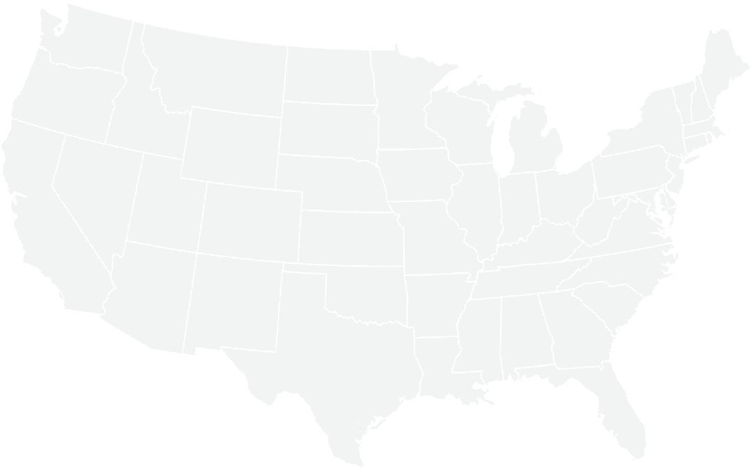
~300
Since 2011
TRUSTED BY
DISTRICTS NATIONWIDE
We scale smart professional learning systems to optimize outcomes in public education.
Providence Public Schools
Providence, RI
Dallas ISD
Dallas, TX
Kentucky DOE
74 KY Districts
Shelby County Schools
Memphis, TN
Bulloch County Schools
Statesboro, GA
Our mission is to help
the neighborhood public school
be the ﬁrst choice for every family.

Slide 3
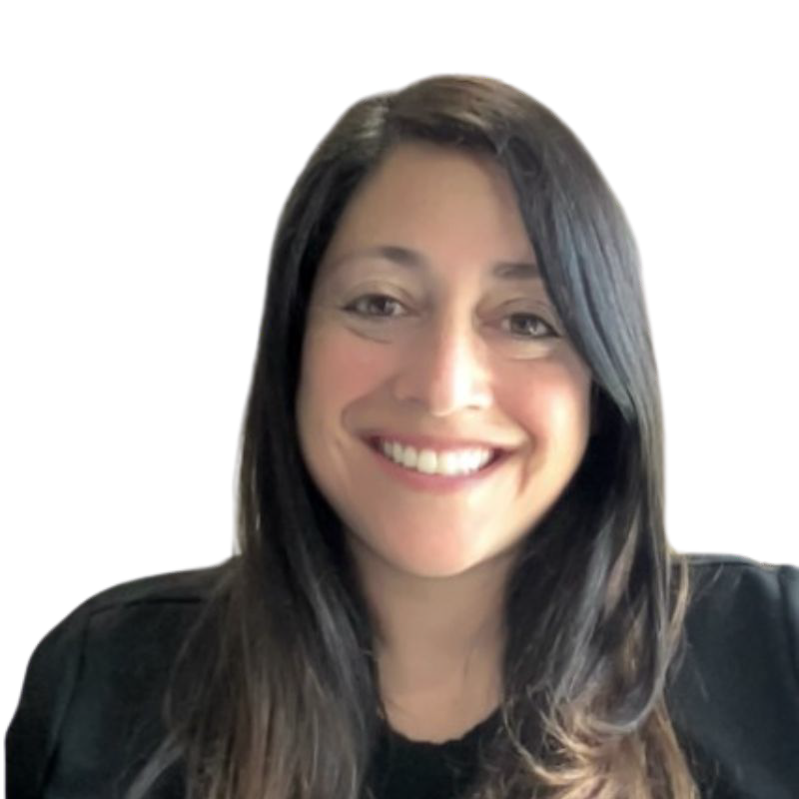
Diana Branch
Executive Director of Partner Success
@ddbranch569 @engage_learning #engage2learn

Slide 4
Guiding Principles and e2L Design Models
Student Focused
Community Based
Aligned & Integrated
Design Thinking
Backwards Design
Actionable

Slide 5
Summits
Focus Groups
Online Survey
Data Disaggregation
Call to Action
Learner Proﬁle
Beliefs
SWOT
Goals/Strategies
5-year sequenced speciﬁc results
Year 1 Action Plan

Slide 6
Engage
Summits (1 day) - 1 Mid-day, 1 Evening
Collaborate with and engage a district strategic planning team, school and district staﬀ, community members and members of the board of education - All Stakeholders involved.

Slide 7
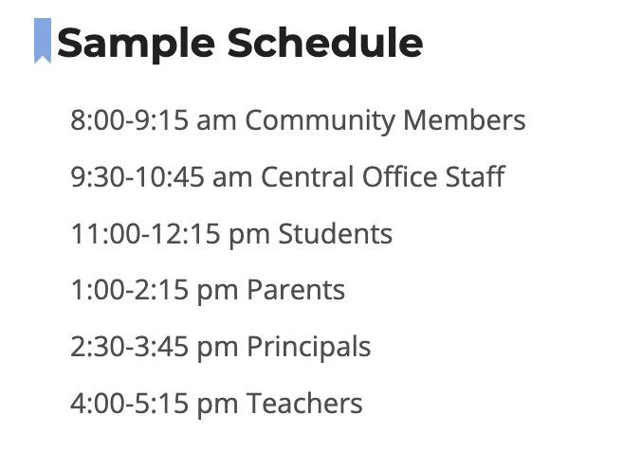
Engage
Focus Groups (1 day) - 4-7 stakeholder groups approx. 1 hour 15 min. each
Gather feedback from Community Members, Staﬀ, Administrators, and Students on their vision for learning and how facilities can support the learning - Speciﬁc Stakeholders involved.
Who will be included in focus groups:
Student Advisory
Teacher Advisory
Parent Advisory
Principal Advisory

Slide 8
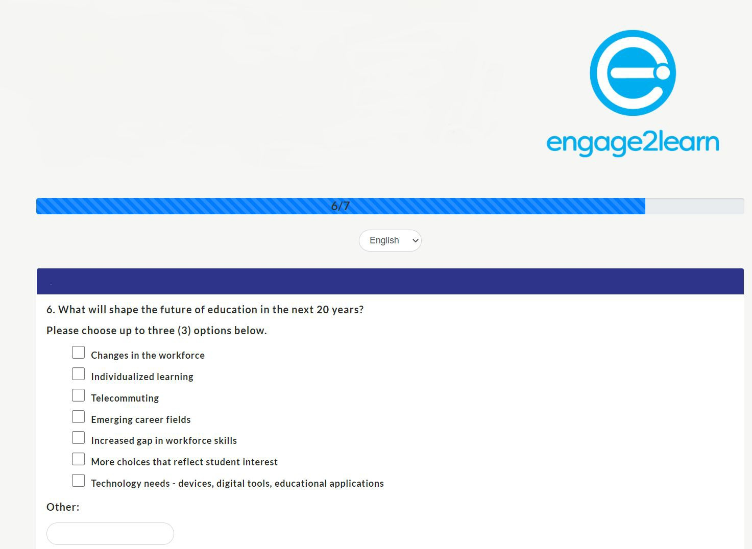
Engage
Online Survey -
Open for 2 weeks, available in English and Spanish
Data Disaggregation
Community Engagement Report: Summary of how the vendor plans to engage students, families, and community stakeholders in the strategic planning process

Slide 9
Design Day (2 Days)
Who will be a part of the design team work for
Design Days
Create Days
Lead Days
A variety of 20-40 stakeholders
Central oﬃce staﬀ
Campus Admin: Secondary and Elementary
Teachers: Secondary & Elementary
Staﬀ
Variety of Schools
Parents: Secondary & Elementary
Community/Business: Clergy, Civic, Higher Ed, City Gov’t

Slide 10
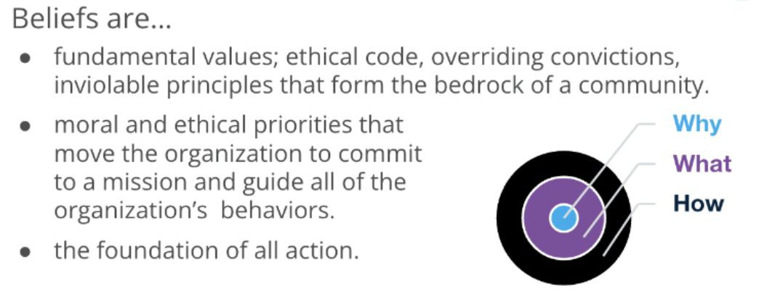
Design Day (2 Days)
Outcomes
Call to Action
Learner Proﬁle
Beliefs
SWOT
Goals/Strategies

Slide 11
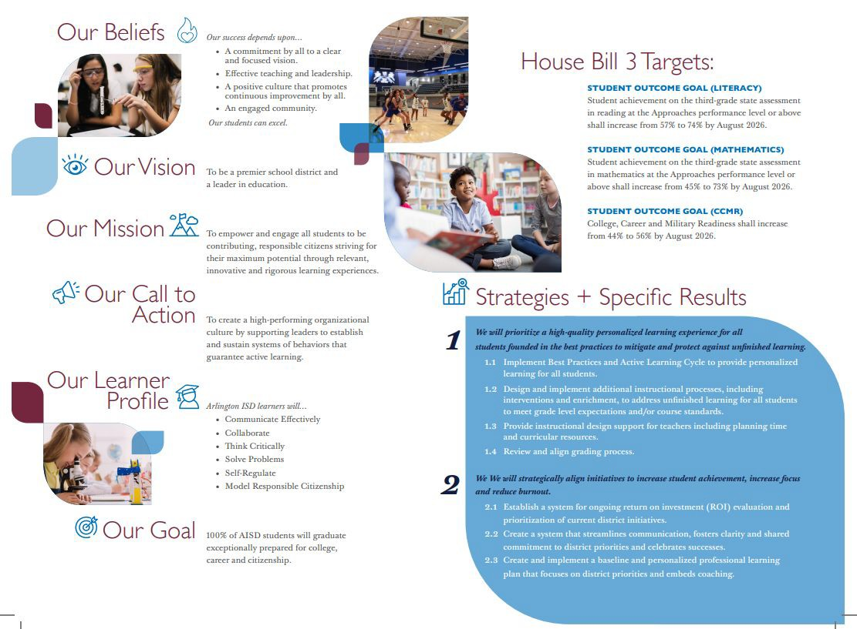
Create (2 Days)
5-year sequenced speciﬁc results

Slide 12
Lead (1 Day)
Outcomes
Year 1 Action Plan
No more than 25% of Speciﬁc Results in Year 1
Quick Wins and High Impact Speciﬁc Results

Slide 13
How will the board be engaged in this process?
Training/Workshops
½ day: Introduce Strategic Design to the Board (Board Retreat)
Core Beliefs
Beliefs to Commitments
Focus Group Questions
½ day to Present Strategic Plan to the board
Presentation of ﬁnal product
Call to Action
Goals
Speciﬁc Results
Final Brochure
Community Summit
Ongoing presentations from administration during board meetings

Slide 14
Leadership Training (1 Day)
Campus Principals/Leadership
1 day leadership training for campus principals: Share the work and facilitate how they can align and implement on their campuses

Slide 15
Looking Ahead
Deliverable | Date(s)
Presentation to the Board Q&A | Oct 20
Focus Groups | Nov 9
Summit | Nov 10
Board Workshop | Nov - TBD
Design | Feb TBD
Create | Mar 14-15
Lead | Mar 16
Board Workshop | Apr 20
Leadership Training | May 9

Slide 16
Questions

