Slide 1
FINANCIAL STATEMENTS
DECEMBER 2018

Slide 2
STATEMENT OF CASH RECEIPTS & DISBURSEMENTS DECEMBER 31, 2018

Slide 3
YEAR-TO-DATE BUDGET REPORT AS OF 12/31/2018 REVENUE DETAIL

Slide 4
YEAR-TO-DATE BUDGET REPORT AS OF 12/31/2018

Slide 5
DEBT SERVICES CASH ANALYSIS DECEMBER 31, 2018

Slide 6
INVESTMENT SUMMARY ACTIVITY ANALYSIS DECEMBER 31, 2018

Slide 7
SPLOST V JULY 2017 TO JUNE 2022 LGIP 8972-63321 DECEMBER 2018

Slide 8
CASH RECEIPTS & DISBURSEMENTS BY ELEMENTARY SCHOOLS DECEMBER 2018

Slide 9
CASH RECEIPTS AND DISBURSEMENTS BY MIDDLE AND HIGH SCHOOLS DECEMBER 2018

Slide 10
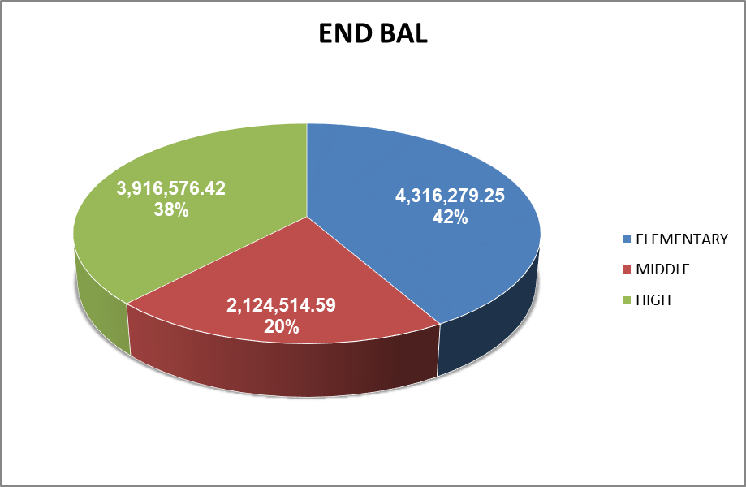
CASH RECEIPTS AND DISBURSEMENTS BY ALL SCHOOLS DECEMBER 2018

