Slide 1
End of Year Results 2016-2017: CCRPI, Graduation Rate, SAT, & ACT

Slide 5
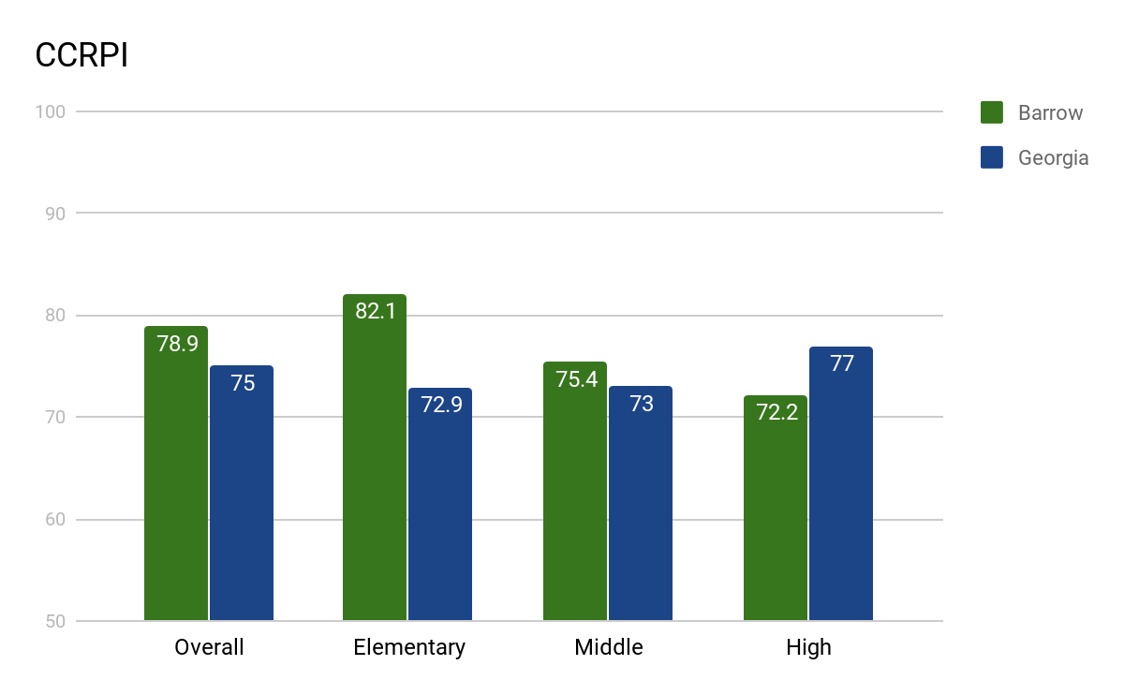

Slide 6
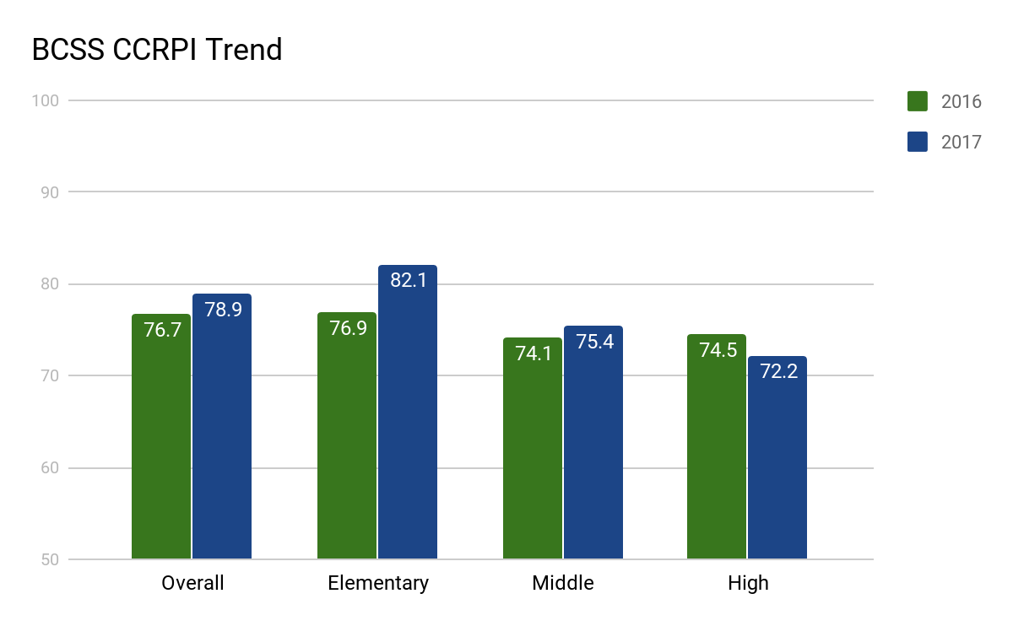

Slide 7
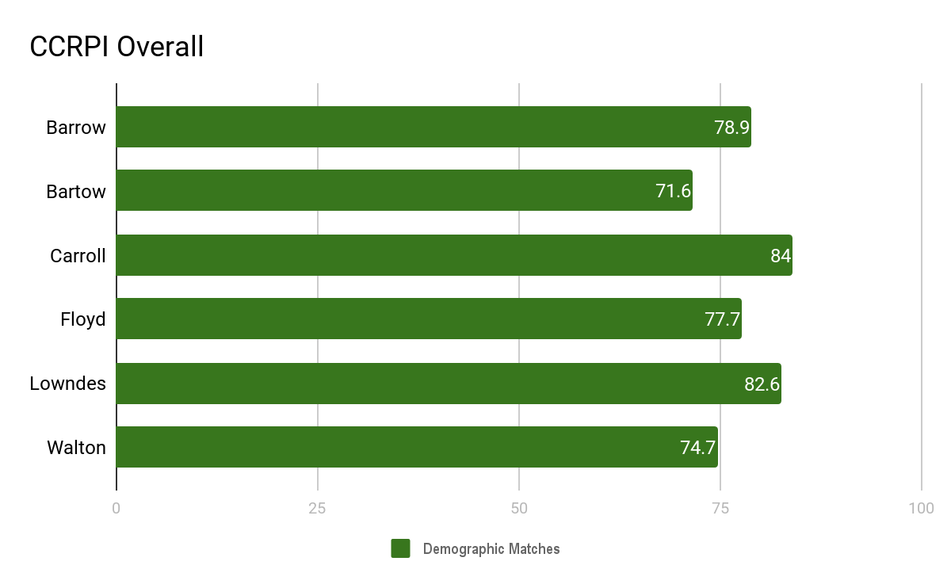

Slide 8
Barrow CCRPI Higher than 76% of Traditional School Districts
BCSS

Slide 9
Graduation Rate Trend

Slide 10
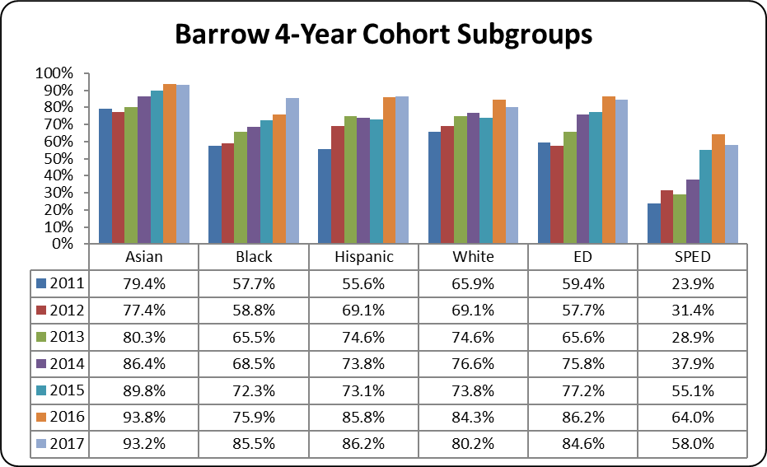

Slide 11
Questions?

