Slide 1
FINANCIAL STATEMENTS
JANUARY 2019

Slide 2
STATEMENT OF CASH RECEIPTS & DISBURSEMENTS JANUARY 31, 2019

Slide 3
YEAR-TO-DATE BUDGET REPORT AS OF 1/31/2019 REVENUE DETAIL

Slide 4
YEAR-TO-DATE BUDGET REPORT AS OF 1/31/2019

Slide 5
DEBT SERVICES CASH ANALYSIS JANUARY 31, 2019

Slide 6
INVESTMENT SUMMARY ACTIVITY ANALYSIS JANUARY 31, 2019

Slide 7
SPLOST V JULY 2017 TO JUNE 2022 LGIP 8972-63321 JANUARY 2019

Slide 8
CASH RECEIPTS & DISBURSEMENTS BY ELEMENTARY SCHOOLS JANUARY 2019

Slide 9
CASH RECEIPTS AND DISBURSEMENTS BY MIDDLE AND HIGH SCHOOLS JANUARY 2019

Slide 10
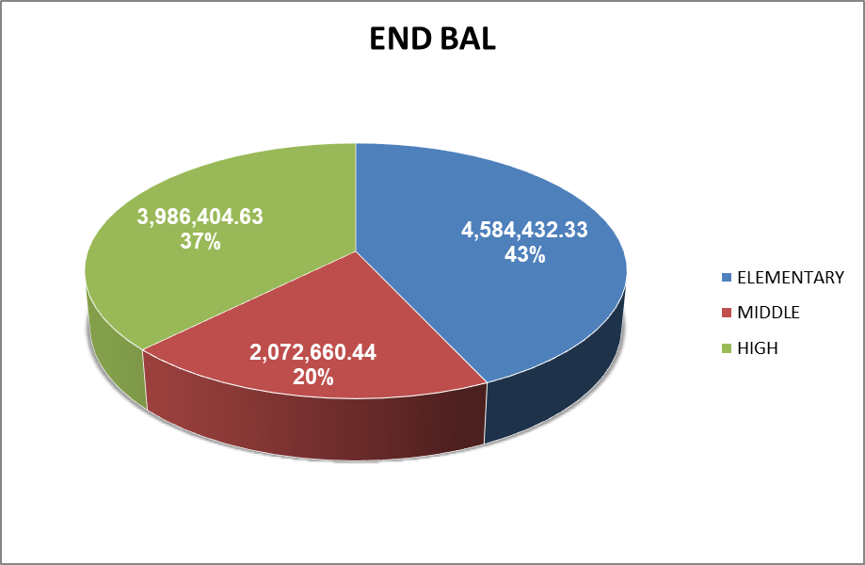
CASH RECEIPTS AND DISBURSEMENTS BY ALL SCHOOLS JANUARY 2019

