Slide 1
YEAR-ROUND SCHOOLS
FEASIBILITY STUDY Update- May 8, 2023 Board of Education Meeting

Slide 2
PROJECT PURPOSE
Chatham County Schools worked with RTI International to assess the feasibility of converting one of our feeder patterns to a year-round academic calendar. The goal of the study is to
educate the staff, families, and students about the potential benefits of a year-round academic calendar,
Share research and general information regarding year-round schools,
assess the support for a transition, and
if feasible plan an implementation over the next 18 months to begin in 2024-2025

Slide 3
Independent Consultants & Partners Independent Nonprofit Research Institute Dedicated to Improving the Human Condition
Staff of 6,000 working in more than 75 countries
Represent experts who hold degrees in more than 250 scientific, technical, and professional disciplines across the social and laboratory sciences, engineering, and international development
Address complex social and scientific challenges on behalf of governments, businesses, foundations, universities, and other clients and partners
Vision
Mission
We address the world's most critical problems with science-based solutions in pursuit of a better future.
Through innovation and technology, WE DELIVER EXEMPLARY OUTCOMES FOR OUR PARTNERS. We support one another in an environment grounded in integrity and respect.
To IMPROVE THE HUMAN CONDITION by turning knowledge into practice.

Slide 4
DISTRICT AND PARTNER ROLES
FAMILIES
Receiving Information
Providing Feedback
Communicating Needs
CHATHAM COUNTY SCHOOLS
Sharing Information
Listening and Learning
Withholding Judgement
DISTRICT PARTNERS
RTI INTERNATIONAL
Walking beside families.
Supporting understanding for families
Neutral to the decision.
Ready to support families and the district IF a transition is made
Partnering with the district
Consulting with the district
Neutral to the decision

Slide 5
PROPOSED FEEDER PATTERN
PROPOSED OPT-OUT SCHOOL
Silk Hope Elementary
Jordan Matthews High
Siler City Elementary
Virginia Cross Elementary
Chatham Middle School
Notes:
Characteristics
Siler City Area
2 Elementary
1 Middle
1 High
Potential Opt-Out Location
3 Title I Schools
3 Restart Schools

Slide 6
HISTORY OF THIS PROJECT
Investigating the question of whether Chatham County Schools should pursue a year-round academic calendar, specifically in the Siler City area, came from our staff, community, and school leaders.
History of lower school performance
Title I Schools
Lower school performance grades
Innovative school strategies have been pursued
Restart applications
Progress to improvement has been noted but slow
Pandemic stalled or reversed some of those gains.
Schools not satisfied with progress
School leaders and staff want to see success for students and have asked for years to investigate this option.

Slide 7
WHY NOW? LIVING, LEARNING AND WORKING THROUGH CONTINUED IMPACTS OF UNFINISHED LEARNING
COVID has changed life, work, and learning
Many of our students’ families and our own family members (spouses, live-in family) have drastically different work lives
COVID unfinished learning is significant
School districts across the nation are making significant changes to academic calendars to facilitate work-life balance and to benefit teacher working conditions
Staffing shortages are higher than ever (despite lower impacts than surrounding districts)
Family challenges have rapidly increased. Caring for sick family members, reconnecting with family, handling critical family issues, and even taking needed vacations are happening at all times of the school year now, not just during traditional holiday times.
This is having a critical and negative impact on student attendance.
COVID stress and mental health needs for students, families, and staff could be addressed with more regular/frequent breaks in learning and work.

Slide 8
Feasibility Study Design
Decision Making Family and Staff Driven
District leadership approached the study with NO OPINION about the outcome
The request to consider a year-round academic calendar originated from our SCHOOL LEADERS and FAMILY/COMMUNITY MEMBERS (pre-pandemic)
To determine feasibility, we assessed and prioritized
STAFF SUPPORT
FAMILY SUPPORT
COMMUNITY PARTNER CAPACITY
OPERATIONAL CAPACITY

Slide 9
How Will We Decide
Assessing Feasibility
Staff Support
Student Learning
We have to ensure we have the most effective staff in order to make this effective for student learning
We have to create a plan that facilitates improved student outcomes as a result of this calendar change
Student learning should be enhanced by this calendar.
Family Support
Operational and Community Support
We need to understand family support for this change and be able to mitigate challenges for families
District operations must be able to equitably and effectively support schools on year-round academic calendars
Community Partners must have capacity to support childcare for families in need

Slide 10
TIMELINE OF ENGAGEMENT
Presentations at each school in the feeder pattern
Assess interest of staff (in Siler City feeder pattern and those in other parts of the district who would want to work in a year-round school)
Family and community information and engagement sessions
Assess feasibility
January /February 2023
February 2023
end March 2023

Slide 11
Staff, Family, Community Engagement Multiple Entry Points to Information and Feedback
DESIGN SESSIONS WITH STAFF/ COMMUNITY LEADERS
IDENTIFICATION OF COMMUNITY PARTNERS
IN-PERSON INFORMATION SESSIONS
QUESTIONNAIRES
3 district lead in person
1 Virtual Session
2 Recorded Sessions
3 School provided sessions
Over 1,000 participants
1 Staff Survey
1 Parent/Community
Over 800 responses
25 Meetings Total 4 School Staff
5 District Sessions
16 RtI Planning Sessions
Identified 7 Partners
Held 5 meetings
Engaged Over 35 people

Slide 12
Year-Round Schools
Legislation
Considerations & Implications for Chatham County Schools

Slide 13
YEAR-ROUND SCHOOLS LEGISLATION
Requirements for year-round schools in North Carolina is covered in the school calendar law (N.C.G.S. 115C-84.2).
Year-round school: “A school with a single- or multi-track instructional calendar to provide instructional days throughout the entire school calendar year, beginning July 1 and ending June 30 by utilizing at least one of the following plans…”
Divides students into four (4) groups and requires each group to be in school for assigned and staggered quarters each school calendar year.
Students are scheduled to attend four (4) quarters of between 43 and 47 instructional days each school calendar year, with vacation periods for students and staff of between 14 and 18 days separating each quarter.
Divides the school calendar into five (5) nine-week sessions of classes and requires each student to attend (4) assigned and staggered sessions out of the five (5) nine-week sessions to complete a student’s instructional year.
In a LEA with both single- and multi-track instructional calendars, a plan for a single-track calendar that is identical to at least one track of a multi-track instructional calendar adopted by the local board that meets the requirements of option 1 or option 3.

Slide 14
Calendar Options (Simplified)
TRADITIONAL CALENDAR
SINGLE-TRACK YEAR-ROUND
Governed by start and end times of NC legislation (Aug 26 & June 11)
185 instructional days or 1025 hours
Total workdays: 195
Calendar runs from July 1 – June 30
Four (4) 9-week blocks of 43-47 days followed by a break of 13-18 days
All students on the same schedule
Eliminates the concerns noted with multi-track year-round schools
All staff are on the same schedule
Staff maintain regular planning time
Teacher classrooms do not transition/change

Slide 15
EXAMPLE CALENDAR 2024-2025

Slide 16
COMPARING CALENDARS Student Days
Break calculations assume some teacher workdays to comply with the statutory 215 required days for teachers
Note: The calendars below are EXAMPLES for comparison purposes only – these are not actual CCS calendars
EXAMPLE TRADITIONAL CALENDAR
ACADEMIC EVENT | DATE
First Day of School | August 26, 2024
First Quarter Ends | October 29, 2024
Second Quarter Begins | October 29, 2024
HOLIDAY BREAK: December 21 – January 3
Second Quarter Ends | January 24, 2025
Third Quarter Begins | January 27, 2025
Third Quarter Ends | April 1, 2025
Fourth Quarter Begins | April 2, 2025
SPRING BREAK: April 18 - 27
Fourth Quarter Ends | June 12, 2025
SUMMER BREAK: Jun 13 – August 25
EXAMPLE YEAR-ROUND CALENDAR
ACADEMIC EVENT | DATE
First Day of School | July 22, 2024
First Quarter Ends | September 20, 2024
BREAK: September 21 – October 13
Second Quarter Begins | October 14, 2024
Second Quarter Ends | December 20, 2024
HOLIDAY BREAK: December 21 – January 13
Third Quarter Begins | January 14, 2025
Third Quarter Ends | March 14, 2025
BREAK: March 15 – April 6
Fourth Quarter Begins | April 7, 2025
Fourth Quarter Ends | June 17, 2025
SUMMER BREAK: Jun 18 – July 21
2 - 3 weeks
2 weeks
2 - 3 weeks
2 - 3 weeks
1 week
8 weeks
3 – 4 weeks

Slide 17
Benefits, Challenges, and Other Considerations

Slide 18
Year-Round Calendars Pros and Cons
Cons
Pros
Do not match the calendars of other schools (in district or feeder).
Provide regular/ extended breaks for staff and students
1
1
Extended times during the year without child-care (families and staff).
Enable extended learning and intervention during inter-sessions
2
2
Lack of alignment to existing district processes/ practices.
Aligns with Community College calendar
3
3

Slide 19
Benefits to Students and Student Learning What the Research Says
IMPROVED STUDENT ACHEIVEMENT
REDUCE SUMMER LEARNING LOSS
IMPROVED TEACHER SATISFACTION
SUCCESSFUL YEAR-ROUND SCHOOLS CO-DESIGN THE PROGRAM WITH STAFF/FAMILIES
STATISTICALLY SIGNIFICANT IMPROVEMENT IN STUDENT TEST SCORES COMPARED TO TRADITIONAL CALENDARS Includes Black, Hispanic, Students from Low-Income Families¹
STUDENTS LOSE ON AVERAGE 25-30% OF SCHOOL-YEAR GAINS IN THE SUMMER. LOWER INCOME STUDENTS READING SKILLS DECLINE AT A MORE SIGNIFICANT RATE WHEN COMPARED TO MIDDLE –INCOME PEERS.²
TEACHERS HIGHLY SATSIFIED. REPORT IMPROVED PSYCHOLOGICAL AND NON-ACADEMIC BENEFITS IN RELATION TO BURNOUT/STRESS.³
THE MOST SUCCESSFUL YEAR-ROUND SCHOOLS RESULT FROM THE CAREFUL PARTNERSHIP WITH STAFF AND FAMILIES TO DESIGN A SUCCESSFUL SUPPORT FOR THE SCHOOL.⁴

Slide 20
Review of the
Survey Feedback

Slide 21
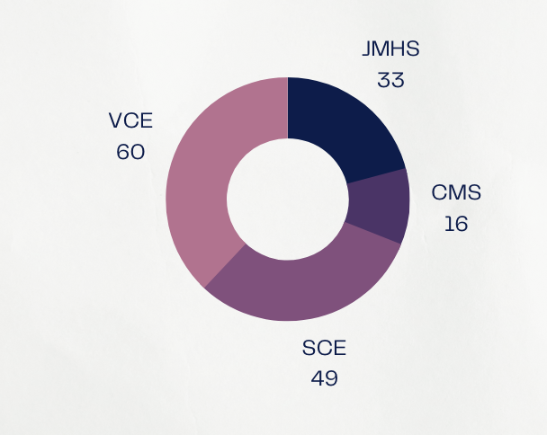
STAFF QUESTIONNAIRE RESULTS
158 Responses Total
(49) 31%: SILER CITY ELEMENTARY
(60) 37.9%: VIRGINIA CROSS ELEMENTARY
(16) 10.1%: CHATHAM MIDDLE SCHOOL
(33) 20.8%: JORDAN MATTHEWS HIGH

Slide 22
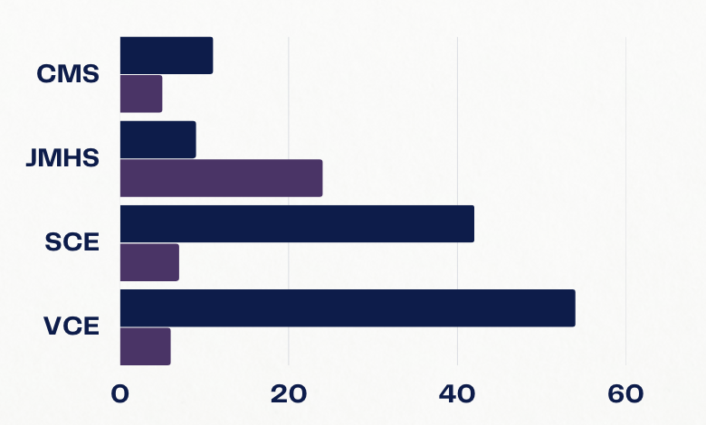
STAFF QUESTIONNAIRE RESULTS
158 Responses Total
Overall In Favor- 116 73.4%
Overall Not In Favor- 42 26.58%
Blue- In Favor
Purple- Not in Favor

Slide 23
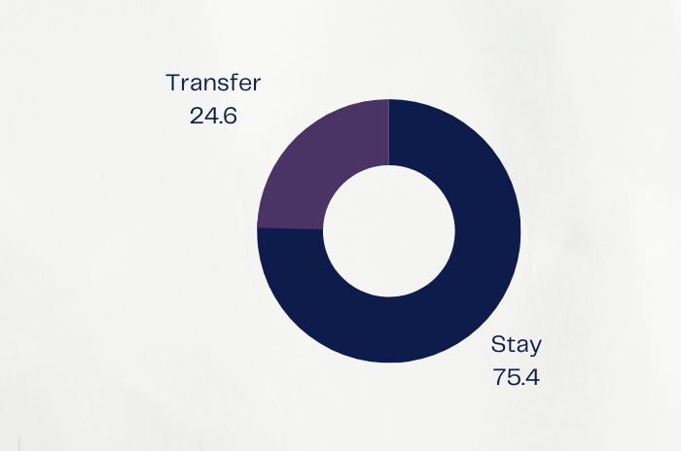
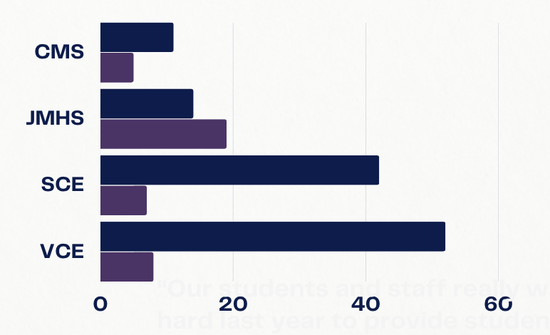
STAFF QUESTIONNAIRE RESULTS
158 Responses Total
Stay at Current School- 119 75.4%
Request Transfer- 39 24.6%

Slide 24
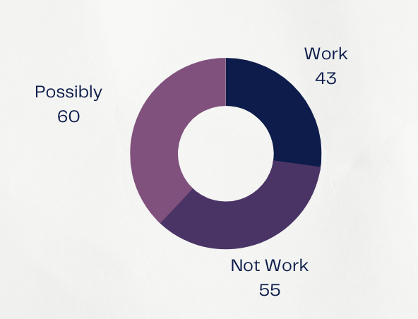
STAFF QUESTIONNAIRE RESULTS
158 Responses Total
Work During Intersessions- 27.2%
Not Work During Intersessions- 34.8%
Possibly Work During Intersessions- 38%

Slide 25
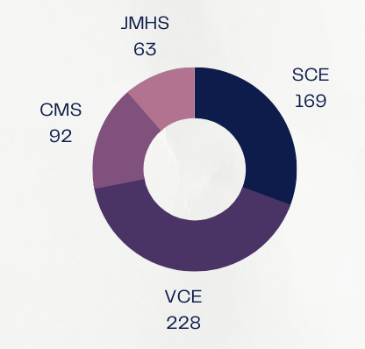
FAMILY QUESTIONNAIRE RESULTS
552 Parent Responses Total
(169) 30.6%: SILER CITY ELEMENTARY
(228) 41.3%: VIRGINIA CROSS ELEMENTARY
(92) 16.6%: CHATHAM MIDDLE SCHOOL
(63) 11.4%: JORDAN MATTHEWS HIGH

Slide 26
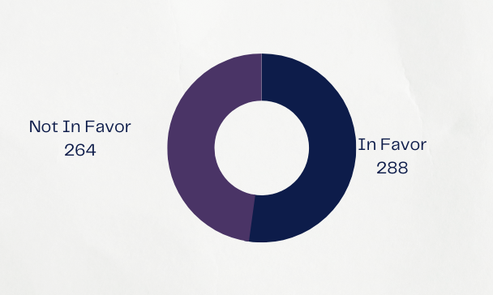
FAMILY QUESTIONNAIRE RESULTS
552 Parent Responses Total
Overall In Favor- 288 52.2%
Overall Not In Favor- 264 47.8%

Slide 27
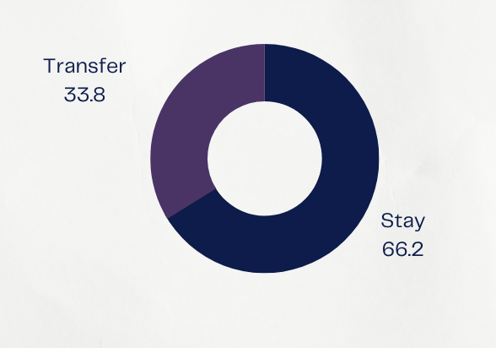
FAMILY QUESTIONNAIRE RESULTS
552 Parent Responses Total
Would Stay- 66.2%
Would Transfer- 33.8%

Slide 28
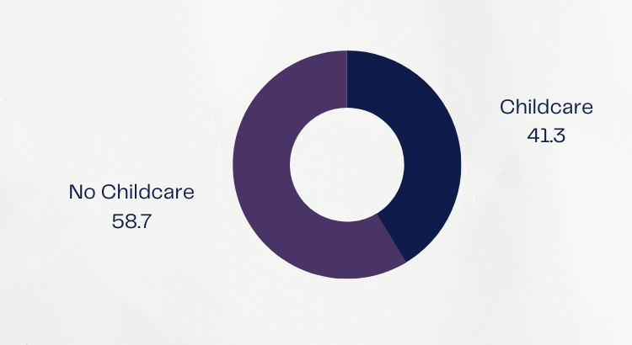
FAMILY QUESTIONNAIRE RESULTS
552 Parent Responses Total
Need Childcare- 41.3%
Do Not Need Childcare- 58.7%

Slide 29
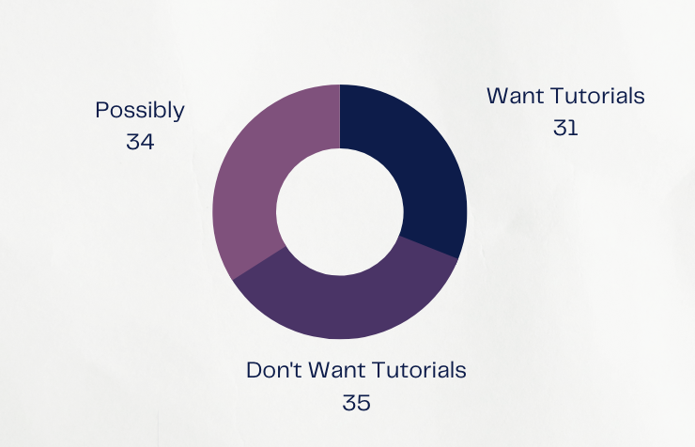
FAMILY QUESTIONNAIRE RESULTS
552 Parent Responses Total
Want Tutorials- 31%
Don’t Want Tutorials- 35%
Possibly- 34%

Slide 30
Benefits
Reduce Summer Learning Loss
Time for staff to give individual attention
Breaks for staff
Time for families to travel more often
Breaks for students
Ability to focus on student needs
Schedule aligned with work or college
Families ability to continue to work
Instructional time more evenly distributed
Most staff wanted to remain in current school

Slide 31
Barriers
Students not being on the same schedule within a family
Childcare
Sports schedules
Staffing for childcare and tutorials
Potentially not enough space for opting out families
Family work schedules
Just hard to understand and change
Staff with children of different schedules

Slide 32
How Will We Decide
Assessing Feasibility
Staff Support
Student Learning
Staff are 73.4% in favor of this effort. Staff are not as interested in working during the intersessions. Many of those not in favor supported the idea but it did not work for their families.
We have the funds to be able to provide tutorials. We have some interest in staff working intersessions, but not as high as we might like. Staff seemed to need/want the breaks.
Family Support
Operational and Community Support
52.2% of families are in favor. Families had concerns with their students being on split schedules. Families had concerns about childcare.
We feel that the district has the capacity to make this shift if it is something desired. However, community partners had concerns with staffing of intersessions. Partners were willing to collaborate but had concerns regarding the ability to staff

Slide 33
Recommendation
The feasibility study reflects that Siler City stakeholders at this time are not prepared to support further research into a year-round school calendar.
As the district anticipates future growth, we recommend the School Board consider further study of innovative school models to include year-round calendar, magnet, or choice schools for staff and families.

Slide 34
QUESTIONS

