Slide 1
New Employee Induction
Celebrating and Supporting New BCSS Employees

Slide 2
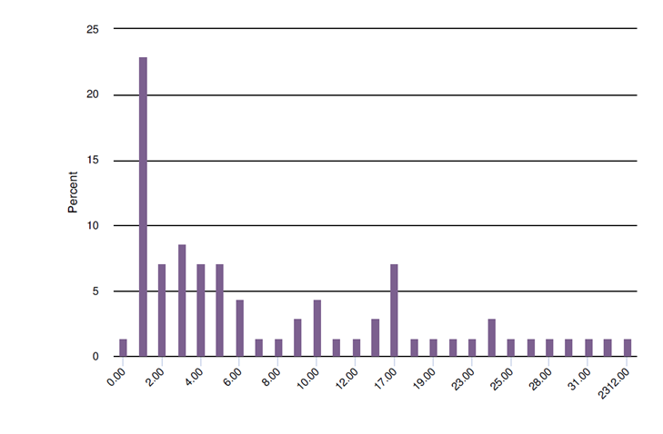
WHY???
Support from District, Supervisors and Colleagues
Years Worked In Barrow County Schools
Notes:
July 1, 2016 and June 30, 2017 (inclusive)
70 respondents

Slide 3
Induction Program Components
Onboarding
New Employee Orientation
District Orientation
Setting Up for Success!
Ongoing Support Throughout the First Year
Coaching and Mentor Support
Individualized Professional Learning
Celebrating Success Together

Slide 4
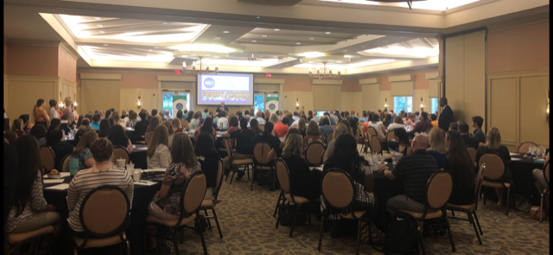

Slide 5
