Slide 1
FINANCIAL STATEMENTS
APRIL 2020

Slide 2
Goal 3 – Effective and Efficient Financial Planning – The FCS Governance Team has a responsibility to be very efficient and effective with the financial resources provided by our state, federal and local government and our citizens.
Action – The superintendent will ensure that the FY’21 budget that is presented to the BOE will meet the needs of our students and will maintain, at a minimum, a projected 15% fund balance.

Slide 3
STATEMENT OF CASH RECEIPTS & DISBURSEMENTS APRIL 30, 2020

Slide 4
YEAR-TO-DATE BUDGET REPORT AS OF 4/30/2020 REVENUE DETAIL

Slide 5
YEAR-TO-DATE BUDGET REPORT AS OF 4/30/2020

Slide 6
DEBT SERVICES CASH ANALYSIS APRIL 30, 2020

Slide 7
INVESTMENT SUMMARY ACTIVITY ANALYSIS APRIL 30, 2020

Slide 8
SPLOST V JULY 2017 TO JUNE 2022 LGIP 8972-63321 - APRIL 2020

Slide 9
CASH RECEIPTS & DISBURSEMENTS BY ELEMENTARY SCHOOLS APRIL 2020

Slide 10
CASH RECEIPTS AND DISBURSEMENTS BY MIDDLE AND HIGH SCHOOLS APRIL 2020

Slide 11
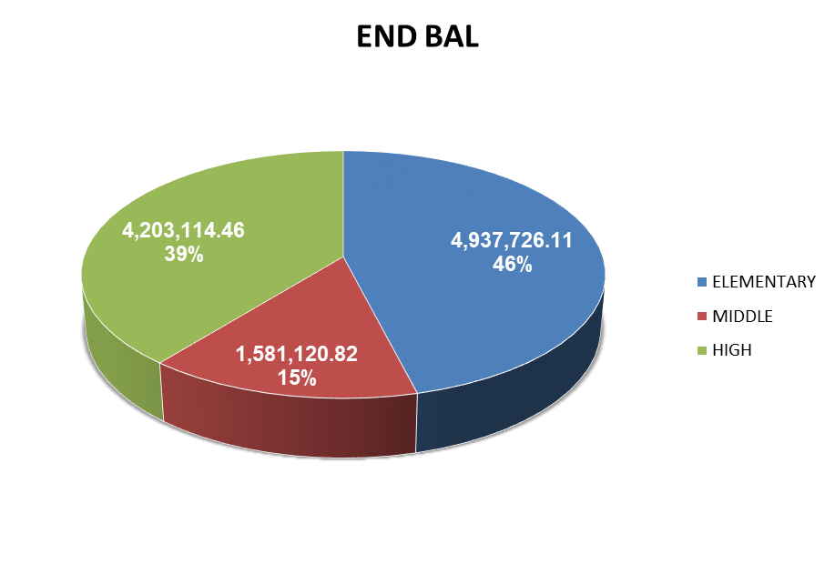
CASH RECEIPTS AND DISBURSEMENTS BY ALL SCHOOLS APRIL 2020

