Slide 1
Electives Survey November 2017
Shenley Rountree
Career, Technical, & Agricultural Education Director

Slide 2
Barrow County Schools
Survey Goals
Goals
1. To determine if we are offering career pathways that align with the interests of our students and with the workforce needs in our region.
2. To determine the optimal location to teach the pathway classes.

Slide 3
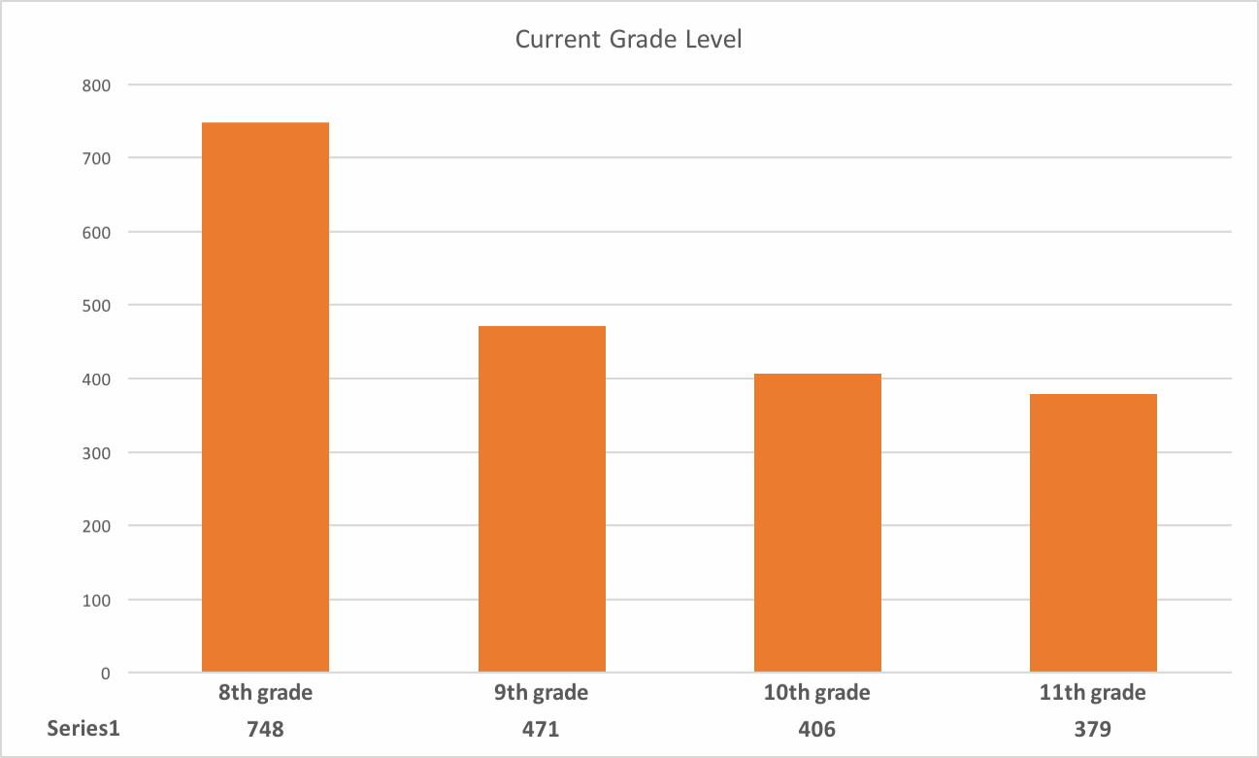
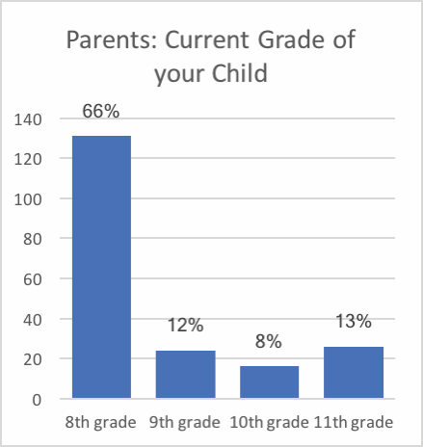
Barrow County Schools
Survey Details
A survey was administered to all current 8th - 11th grade students by cluster (AHS/WBHS) to identify the electives that students were most interested in taking.
Total Student Responses (orange): 2,004
Total Parent Response (blue): 197
Notes:
The survey was given to high school students on Wed, Nov 1st and to 8th graders between Nov 1 - Nov 6th. A version was also sent to all parents (using ParentLink) between Nov. 1 and Nov. 6th to complete.

Slide 4
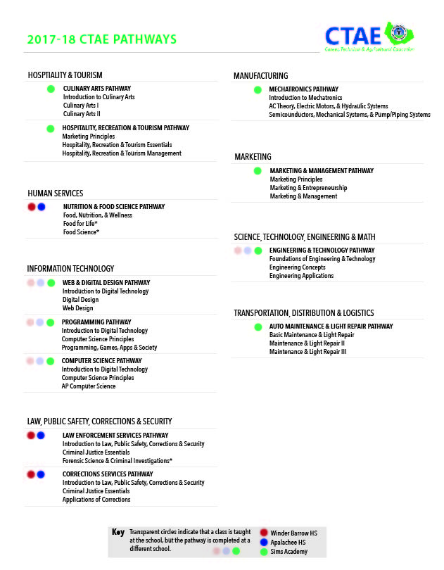
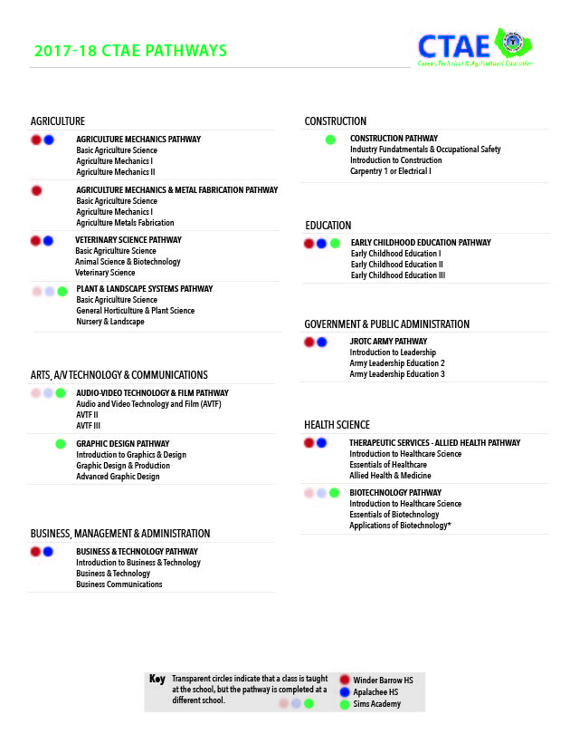
Barrow County Schools
24 Current Pathways Offered

Slide 5
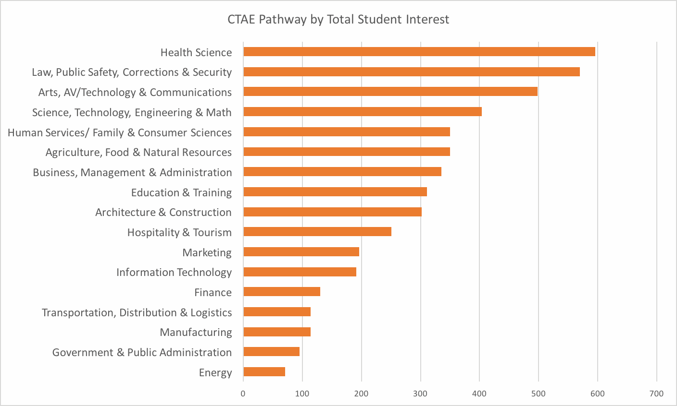
Barrow County Schools
Top Pathways of Interest - Students

Slide 6
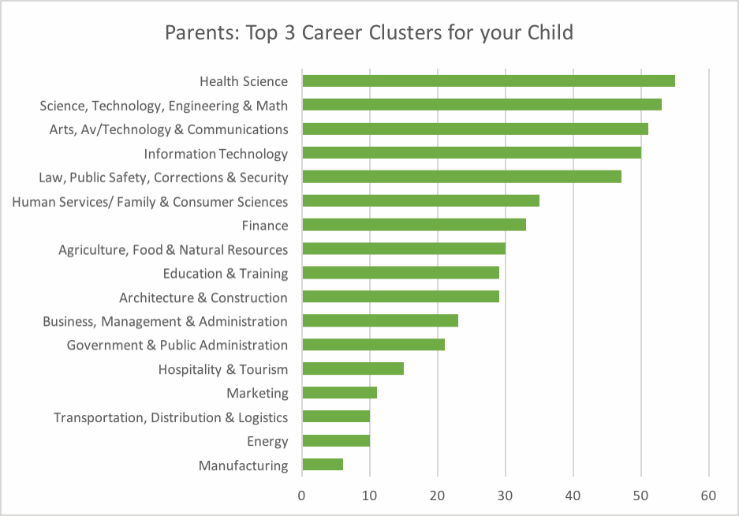
Barrow County Schools
Top Pathways of Interest - Parents
Notes:
Comparision between Parent & Student Responses:
- Parents ranked STEM #2; students #4
- Parents ranked Information Technology #4; students #12
- Both listed manufacturing & energy in the bottom 3

Slide 7
Barrow County Schools
Workforce Needs
Identified workforce needs in our community:
Economic Development:
Hospitality & Tourism
Information Technology
Manufacturing
STEM
Transportation, Distribution & Logistics
Chamber of Commerce:
Agriculture
Business, Management & Administration
Hospitality & Tourism
Health Science
Transportation, Distribution & Logistics
STEM
Notes:
The survey was given to high school students on Wed, Nov 1st and to 8th graders between Nov 1 - Nov 6th. A version was also sent to all parents (using ParentLink) between Nov. 1 and Nov. 6th to complete.

Slide 8
Barrow County Schools
Post-Graduation Plan
71% of students plan to attend a 4 year college

Slide 9
Barrow County Schools
Post-Graduation Reality
For the graduating
class of 2015,
45% of students
were enrolled in a 4 year college one year after high school graduation.

Slide 10
Barrow County Schools
Post-Graduation Reality
From the graduating
class of 2010, only
24% of students
earned a post-secondary credential five years after graduation.

Slide 11
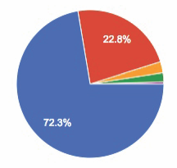
Barrow County Schools
Post-Graduation Reality
71% students plan to attend 4 year college
24% of students have earned a post-secondary credential (12% still enrolled)
vs

Slide 12
Thank you!

