Slide 1
Policy DJED: Bids and Quotations Revision Proposal

Slide 2
Currently DJED requires that 3 formal quotes are secured prior to any purchase over $500 including for office and classroom supplies.
We would like to raise this threshold to $5,000.
We would still require bookkeepers to carry out due diligence in obtaining the best price for the school district for purchases under this amount.
State contract prices have been beat at times when quoted out, so we would like to remove this exception. (see Regulation)

Slide 3
Reason for the Request
Process is too time consuming
Bookkeeper seeking vendors and retrieving 3 quotes – 25 minutes
Director/Principal reviewing 3 quotes – 5 minutes
Scan quotes into Requisition – 2 minutes
Assist Superintendent review of Quotes – 3 minutes
Total 35 minutes Approximately 1,300 Requisitions between $500 and $5,000 so 758 hours saved.
WAIT for a response, 2 may respond immediately, but you can’t buy until the 3rd one responds.
Hard to find vendors that will respond and do quality work for a small amount of money.

Slide 4
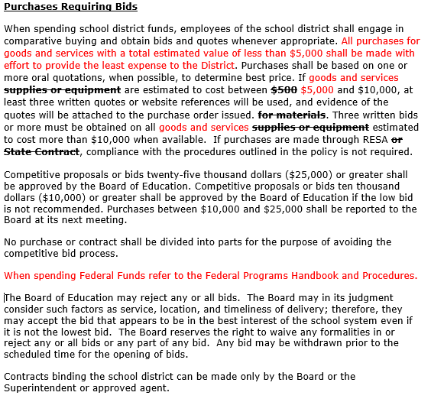

Slide 5
Other Districts
School District | Over this amount - Formal quotes/bids
Barrow | $ 500.00
Oconee | 500.00
Houston | 1,000.00
Paulding | 1,000.00
Dougherty | 1,000.00
Lowdens | 2,000.00
Camden | 2,500.00
Douglas | 2,500.00
Liberty | 2,500.00
Whitfield | 2,500.00
Troup | 2,500.00
Floyd | 3,000.00
Walton | 3,000.00
Clarke | 3,500.00
Glynn | 3,500.00
Bartow | 5,000.00
Coffee | 5,000.00
Hall | 5,000.00
Colquitt | 5,000.00
Carroll | 5,000.00
Lowndes | 10,000.00
Walker | 10,000.00

Slide 6
Informational Purposes DJED - Regulation

Slide 7
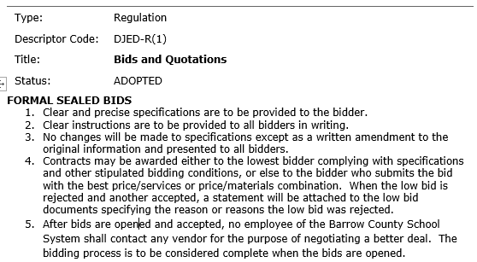
Regulation DJED-R

Slide 8
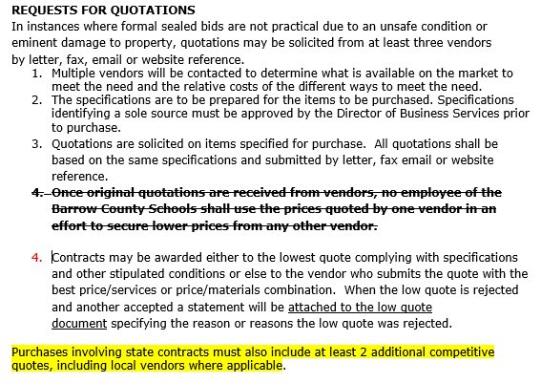
DJED – R Continued

