Slide 1
TOM GLOVER Dedicated Teacher, Coach, Administrator and Board of Education Trustee

Slide 2
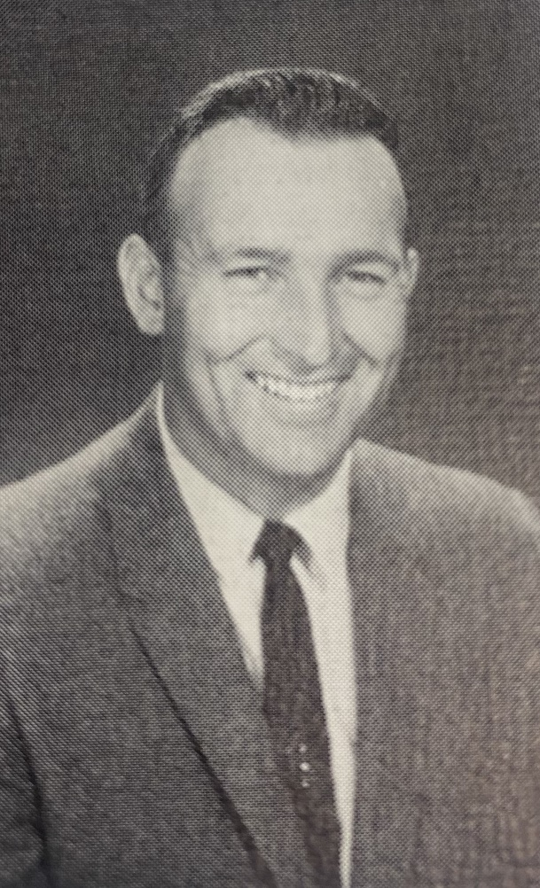
El Molino Woodshop and Photography Teacher Varsity Head Baseball Coach

Slide 3
1964

Slide 4
Tom’s sons join the Baseball Team at the Bat Boys

Slide 5
1965 El Molino Teaching Staff

Slide 6
1967

Slide 7
1972

Slide 8
1973 Analy Dean of Students

Slide 9
Analy Vice Principal 1974-1978

Slide 10
Laguna Principal 1978-1982

Slide 11
Tom Glover returns to el Molino as the principal 1982-1990

Slide 12
FRANK ANDERSON, EL MOLINO ALUMN JOINS TOM’S
ADMINISTRATIVE TEAM AS A VICE PRINCIPAL

Slide 13
TOM GLOVER RETURNED TO LAGUNA HIGH SCHOOL TO SERVE AS PRINCIPAL UNTIL HE RETIRED IN JUNE 1998

Slide 14
WSCUHSD Board of trustee 2002-2006

Slide 15
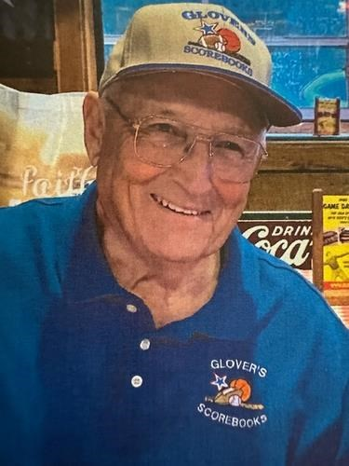
IN MEMORY OF TOM GLOVER
TEACHER, COACH, ADMINISTRATOR AND TRUSTEE
WHO HAD AN ENORMOUS IMPACT ON THE LIVES OF MANY STUDENTS AND COLLEAGUES
REST IN PEACE MR. GLOVER

