Slide 1
Supporting Students with Mental Health Issues in Barrow County
Notes:
Matt

Slide 2
2016-2017 Georgia Student Health Survey
% Barrow MS and HS Students reporting feeling ___ on 3 or more of the previous 30 days
Sad or withdrawn | 28.9%
Overwhelmed with fear | 17.9%
Intense worry | 12.8%
Severe mood swings | 13.8%
Out of control behavior | 6.1%
Extreme Difficulty Focusing | 9.6%

Slide 3
Three Components of a Mental Health Support System
Building knowledge base/awareness
Building capacity & resources
Building collaborations and networks

Slide 4
Mental Health First Aid
Collaboration between Georgia Department of Education and Substance Abuse and Mental Health Services Agency (SAMHSA)
Focuses on equipping educators and school staff with knowledge and skills to provide mental health “first aid” to students in need and direct them to services and help
Training at PDC on 11/3/2017
2 Principals
8 Assistant Principals
4 Counselors
10 Nurses
1 Social Worker

Slide 5
Trauma Series
Three Courses:
Trauma 101: Understanding the Impact of Trauma on Children
Brain Development 101: Understanding the Impact of Trauma on Brain Development
Trauma/Brain 201: Building Resiliency
Provided by Georgia State University
Three full days over a period of three months (February to April, 2018) hosted at the PDC
14 Counselors
3 Social Workers
1 Parent Engagement Specialist
10 Participants from other local agencies

Slide 6
Suicide Prevention Summit
Collaboration between Georgia Department of Education, Behavioral Health and Developmental Disabilities (DBHDD), Georgia Bureau of Investigations (GBI), & Mercer University
Teams from multiple districts met to discuss suicide prevention strategies, research, and review data on suicidal ideation
Held at the PDC in November, 2017
Barrow County team included:
2 Social Workers
3 Counselors

Slide 7
Dialectical Behavior Therapy (DBT) Training & Resources
Cognitive behavior treatment emphasizing helping students learn and use new skills and strategies to deal with issues
Includes components of mindfulness, emotional regulation, distress tolerance, and interpersonal effectiveness
Initial Training to be held on April, 30th at Sims Academy
Current RSVP
20 counselors
3 social workers
2 principals
Each school has received a DBT manual
We are looking at offering follow up training in the fall of next school year

Slide 8
Youth Behavioral Health Summit
Held on March 19th, 2018 (much gratitude to Bethlehem Church for hosting)
Nearly 200 attendees
Topics Included:
Impact of early childhood experiences on developing mind
Asperger Syndrome and comorbid psychiatric problems
Treatment of common psychiatric disorders in children
Trust Based Relational Intervention
Mindfulness: A DBT informed understanding

Slide 9
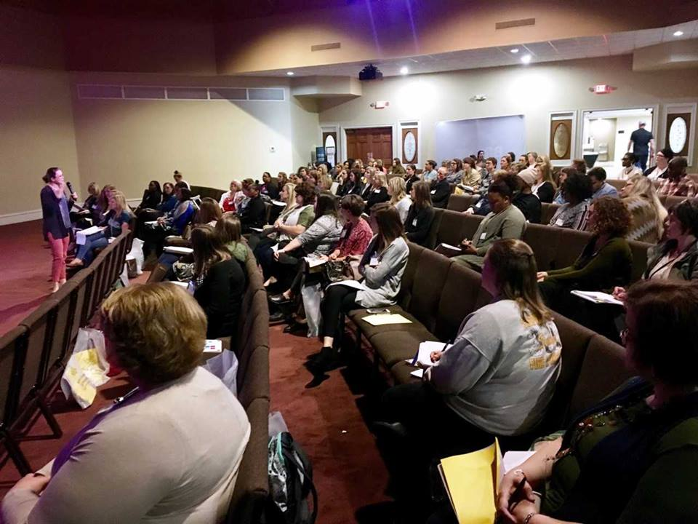
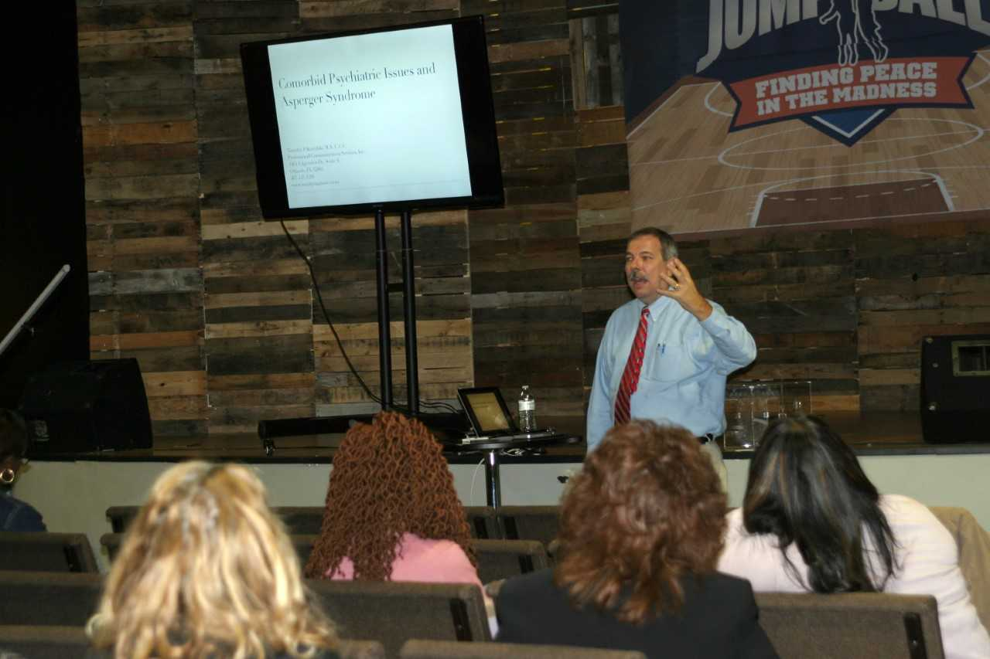
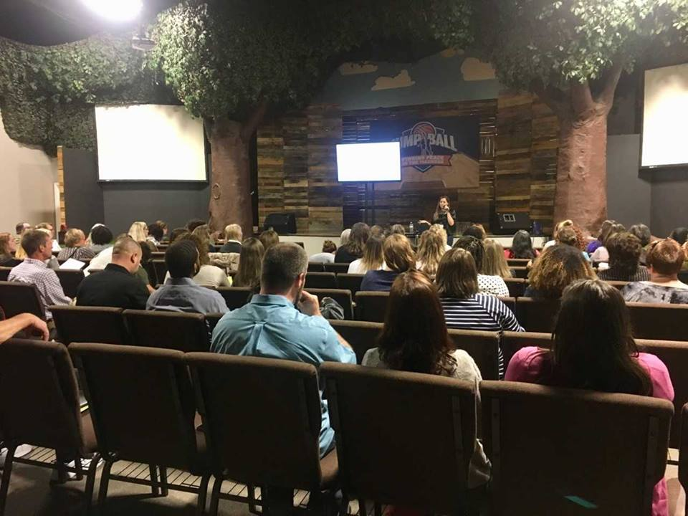

Slide 10
CISM: Critical Incident Stress Management
Community team made up of individuals that respond to tragedies and high grief needs and help provide support and stability to those affected
A broader, community version of the Crisis Response Team (CRT) that we operate in the Barrow County School System
Training was offered March 14-15
2 Social Workers
1 Counselor
Many of our CRT staff have already had this training, so this was a chance to supplement those numbers

Slide 11
Local Interagency Planning Team (LIPT)
Monthly meeting structure that includes DFCS, DJJ, and other core providers (mental health providers that have a Medicaid contract with state)
Intense problem solving through very difficult cases in which students are at risk of being removed from community due to mental health issues
Attempts to provide solutions and resources to turn around severe student dysfunction
Nine BCSS students staffed this year with two more scheduled for May

Slide 12
Children in Need of Service: CHINS
Similar structure and participants as LIPT
Problem solving through very difficult cases for students who have status offenses on their record
Attempts to provide solutions and resources to turn around severe student dysfunction and pair students with resources, including mental health support
Generally, 3 to 5 students staffed in CHINS per month

Slide 13
What’s Next?
Continuing to increase skills and capacities of those who serve students
Broaden base of Mental Health First Aid across district
Build relationships and networks of support with community agencies and partners to provide outside support for students
Continue current initiatives that have shown effectiveness

Slide 14
Questions?

