Slide 1
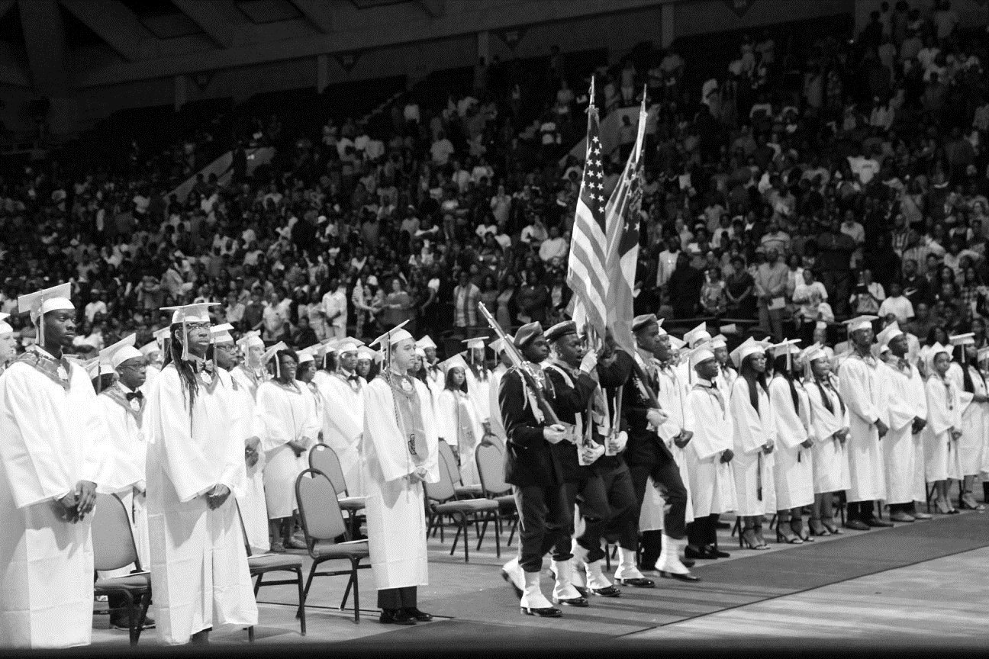
BCSD Virtual Graduation Update
Jamie Cassady, Assistant Superintendent
Bibb County School District
July 16, 2020
P-2

Slide 2
Who We Are
OUR VISION
Each student will demonstrate strength of character
and will be college or career ready.
OUR MISSION
The Bibb County School District develops a highly trained
staff and an engaged community dedicated to educating
each student for a 21st century global society.
OUR VALUES
COMPETENCE LOYALTY OPEN COMMUNICATION DEFINED AUTONOMY HONOR
OUR NON-NEGOTIABLES
PBIS
RTI
FIP
TKES & LKES

Slide 3
VICTORY IN OUR SCHOOLS!
Overriding Objective = CCRPI > 70
STUDENT ACHIEVEMENT
Increase
Content Mastery
Increase Post School
Readiness
Increase Grad Rate and Post Secondary Options
STRATEGIC PRIORITIES
Priority 1: Get students reading on grade level.
Priority 2: Be successful on the Georgia Milestones.
Priority 3: Increase the number of students in school every day.
Priority 4: Close the knowing-doing gap.
Priority 5: Work hard to support schools.
Priority 6: Establish a culture of accountability for everyone.
STUDENT AND STAKEHOLDER ENGAGEMENT
Partner
with Students
Partner
with Parents
Partner
with the Community
LEADER AND TEACHER EFFECTIVENESS
Be
A PLC
Know
Technology
Do
Standards-Based Classrooms
INTERNAL PROCESSES
RELIABLE ORGANIZATION
Manage
Processes and Projects
Manage
Finances and Personnel
Manage
Perceptions
Maintain a Safe Learning Environment
LEARNING AND GROWTH
Recruit and Retain
The Right People
Respect
BCSD Values and Culture
Grow
From Evaluations

Slide 4
Why Virtual?
Surge in cases (408-7/6/20 vs 778-7/13/20) Operational Summary
Increase in Emergency Room Visits
Safety of Students, Staff and Community

Slide 5
Recording of Graduates for Virtual Ceremony
July 22nd – 24th, graduates will have the opportunity to be filmed marching across stage in their cap and gown.
BCSD Location: Professional Center Annex
Wednesday July 22 | Thursday July 23 | Friday July 24th
Howard HS – 8:00 AM (256) | Central HS – 8:00 AM (231) | Rutland HS – 8:00 AM (180)
Southwest HS – 11:00 AM (164) | Northeast HS – 11:00 AM (156) | Westside HS – 11:00 AM (186)

Slide 6
Recording of Graduates for Virtual Ceremony
Recording times will be staggered for precautionary measures to reduce contact while abiding by social distancing guidelines.
8:00 AM | 8:25 AM | 8:50 AM | 9:15 AM | 9:45 AM
A – E | F – J | K – O | P – T | U - Z
11:00 AM | 11:25 AM | 11:50 AM | 12:15 PM | 12:45 PM
A – E | F – J | K – O | P – T | U - Z

Slide 7
Logistics – Schools & Administrators
Each school will report at their designated time.
Principals and staff must wear a mask.
Principals must be in graduation regalia.
Each Principal will designate at least 5 (or more) staff members to assist with their school recording.
Graduates will pick up their diploma cover prior to reaching the steps leading to the stage.
The only individuals on stage will be the student, the principal, and possibly the name caller (off to the side).
Each school’s backdrop will be placed in the center of the stage.

Slide 8
Logistics - Students
Graduates must wear regalia.
Graduates must wear a face mask.
Graduates will line up, spaced 6 - 10 feet apart.
Graduates will be notified when to move forward.
After picking up diploma cover, the graduate will walk towards backdrop, pause in front of the school’s backdrop for name calling, stop for a picture, then exit the stage.
Once graduates have exited the stage, they must immediately go to their vehicle and leave the premises.
For those graduates not present, a picture may be displayed with their name called.

Slide 9
Pictures & Speeches
Upon exiting the stage, graduate will pose for a picture with diploma cover in hand.
Creative-Pro Studio is our photographer.
As in previous years, students will be able to go to www.creativeprophoto.com to retrieve their graduation picture.
Wearing a face mask when they take their picture will be optional due to graduate being 6-10 feet away from anyone else.
All speeches (students & principals) that were recorded in June will be incorporated into the graduation event next week.
A recording of the Superintendent and Board Member reading their certification will take place next week.

Slide 10
Notification
Graduates and parents have been notified of the recordings that will take place next week. This will be pushed heavily this week and next week to ensure that this information is communicated to all students who wish to participate.
An automated call will be sent out to all graduates/parents.
Notification was posted on each school’s website as well as on the district’s website page and social media.
The recording times are for students only. Parents will not be allowed in the recording area.
It will be stressed that there will be no socializing. This will be strictly enforced

Slide 11
Campus Police Department
Will assist in providing the best way to route vehicles in and out of the parking lot safely in an orderly fashion.
Will assist with traffic entering and exiting the parking lot.
Will coordinate efforts with Bibb Co. Sherriff's Department to assist with directing traffic at the signal light (Riverside@ Ingleside) as well as entry and exit points to PLC/SOAR Parking lot.
Will assist schools in making sure that students leave the premises after exiting the building.

Slide 12
Safety Measures
District staff and participants will adhere to all CDC guidelines (social distancing, no congregating, wearing masks, etc.)
Hand sanitizer will be available to students and staff
Masks will be provided to anyone who does not have one.
Students will be directed into the building in staggered groups.
Students will remain in their vehicle until it is time for their group to report.
Parents will not be permitted to enter the PLC Annex recording area.

Slide 13
Virtual Graduation July 29 & 30
July 29th
July 30th
Recording will be available for viewing via YouTube and/or streaming via the district’s website.
10:00 AM | 2:00 PM | 6:00 PM
Howard | Southwest | Central
10:00 AM | 2:00 PM | 6:00 PM
Northeast | Rutland | Westside

Slide 14
Questions

