Slide 1
CY 2018 Tentative Millage Rate

Slide 2
Property Taxes
Property taxes account for approximately 30% of the Districts Revenues for FY 2018 and 2019.
All real property and all personal property are taxable unless the property has been exempted by law.
Real property is land and generally anything that is erected, growing or affixed to the land
Personal property is everything that can be owned that is not real estate. (Boats, airplanes, business machinery and equipment, business inventory, etc)
Vehicles – usually older, that are still on the “Birthday Tax”
The contents of your household are not normally taxable unless they are used for a home-based business

Slide 3
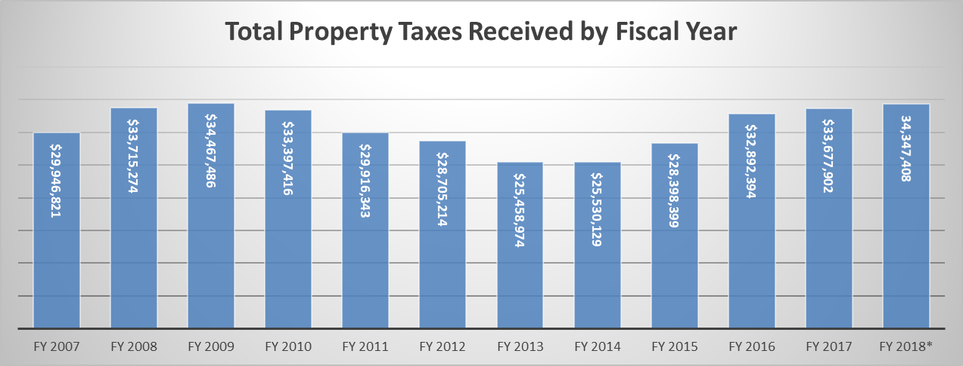
Property Tax Collections
*FY 2018 still has 4 more months of collections not recorded
**TAVT tax has been included

Slide 4
Tax Digest and Millage Rate
The tax digest is the official list of each taxpayer subject to property taxes together with the assessment (40% of property value) and the amount of taxes
The tax digest is prepared by the Tax Commissioner based on information obtained by the Tax Assessor
Assessed value is defined as being 40% of the fair market value.
The tax rate for the BCSS, or millage rate, is set annually by the Board of Education. A tax rate of one mill represents a tax liability of one dollar per $1,000 of assessed value.
The School Systems millage rate is currently 18.5

Slide 5
Barrow County Median School Tax
Median home value in Winder is $119,700*
40% taxable value = $47,880
Less Homestead Exemption of $2,000 = $45,880 value
18.5 Millage rate = $848.78 In School Tax
* US Census 2015 – Median Home Value

Slide 6
Tax Digest
Tax Digest is by Fiscal Year, meaning that FY 2007 would have been the digest for September 2006
FTE in 2007 =11,409, 583 SPED
FTE in 2018 = 13,809, 1,085 SPED
Increase of 2,400 FTE which includes an increase of 502 SPED.
Projected FTE used for allotments for 2019 is 14,422

Slide 7
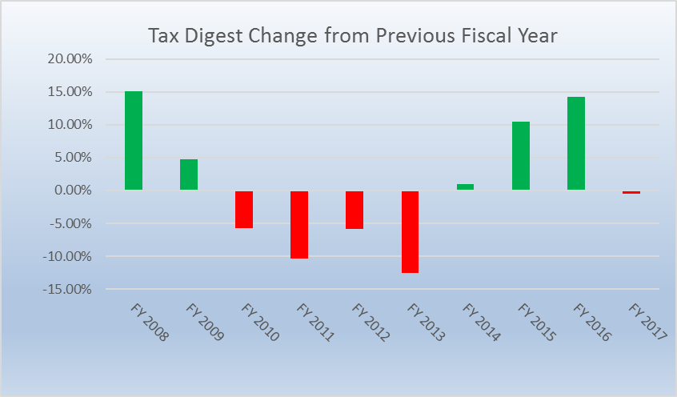
Ups and Downs of Property Values
Notes:
Change to FY at bottom 2010 to 2017

Slide 8
Property Tax Income Per FTE

Slide 9
2018 Tax Digest

Slide 10
What Happened? 2018 Digest
The net digest increased by 13.86%
The tax assessor reassessed property that was already on the digest for an increase of $242,583,281
New real property (construction) increased by $32,976,850
Personal Property (mostly business furniture, machinery and inventory) increased by $33,934,747
Automobiles still on the Birthday tax decreased by $14,372,210

Slide 11
Increases (Decreases) in Tax Digest

Slide 12
Millage Rollback in Effect
A millage roll back is based on reassessments of property that was already on the digest for 2018.
$242,583,281 was added to our digest because of an updated value, if we decrease our millage by 2.079 to 16.421 then we would receive the same amount of tax money as the previous year on the property that was on the digest in 2017. (excluding new exemptions)

Slide 13
Millage Rate History

Slide 14
Decision

Slide 15
Newspaper Advertisement

Slide 16
5 Year History - Advertisement

Slide 17
Important Dates
June 5, 2018 6 PM – Approve Tentative Millage Rate
June 21, 2018 9 AM – First Public Hearing
June 21, 2018 6 PM – Second Public Hearing
June 28, 2018 5PM – Third Public Hearing
June 28, 2018 6:00 PM Thursday –Called meeting -Vote on Millage Rate

