Slide 1
2017 Tentative Millage Rate

Slide 2
Property Taxes
Property taxes account for approximately 30% of the Districts Revenues for FY 2017 and 2018.
All real property and all personal property are taxable unless the property has been exempted by law.
Real property is land and generally anything that is erected, growing or affixed to the land
Personal property is everything that can be owned that is not real estate. (Boats, airplanes, business machinery and equipment, business inventory, etc)
Vehicles – usually older, that are still on the “Birthday Tax”
The contents of your household are not normally taxable unless they are used for a home-based business

Slide 3
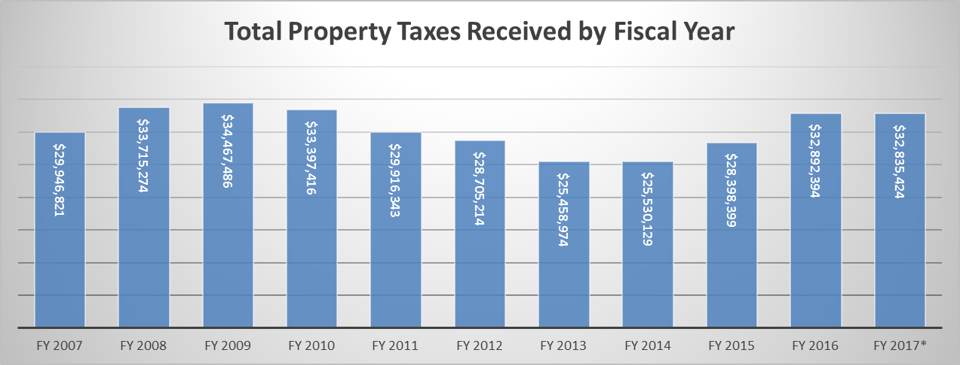
Property Tax Collections
*FY 2017 still has 2 more months of collections not recorded
**TAVT tax has been included

Slide 4
Tax Digest and Millage Rate
The tax digest is the official list of each taxpayer subject to property taxes together with the assessment (40% of property value) and the amount of taxes
The tax digest is prepared by the Tax Commissioner based on information obtained by the Tax Assessor
Assessed value is defined as being 40% of the fair market value.
The tax rate for the BCSS, or millage rate, is set annually by the Board of Education. A tax rate of one mill represents a tax liability of one dollar per $1,000 of assessed value.
The School Systems millage rate is currently 18.5

Slide 5
Barrow County Median School Tax
Median home value in Winder is $119,700*
40% taxable value = $47,880
Less Homestead Exemption of $2,000 = $45,880 value
18.5 Millage rate = $848.78 In School Tax
* US Census 2015 – Median Home Value

Slide 6
Tax Digest
* Tax Digest is by Fiscal Year. Meaning that FY 2007 would have been the digest for September 2006

Slide 7
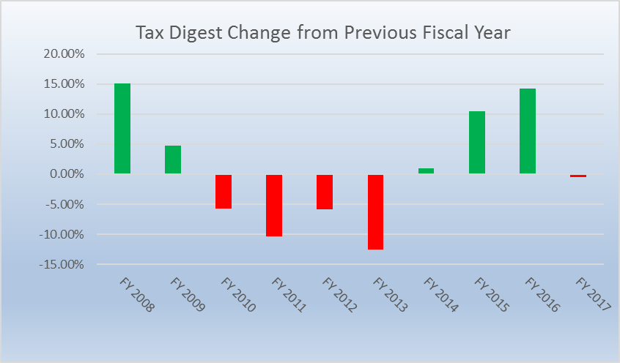
Ups and Downs of Property Values
Notes:
Change to FY at bottom 2010 to 2017

Slide 8
* FY 2018 - Estimated

Slide 10
2017 Tax Digest

Slide 11
What Happened? 2017 Digest
The net digest increased by 9.82%
The tax assessor reassessed property that was already on the digest for a increase of $138,304,622
New real property (construction) increased by $56,522,155
Personal Property (mostly business furniture, machinery and inventory) decreased by $16,403,207
Automobiles still on the Birthday tax decreased by $19,054,200

Slide 12
Exemption Recap

Slide 13
Increases (Decreases) in Tax Digest

Slide 14
Freeport Exemption
Originally enacted in 1976 and subsequently amended several times, Georgia's Freeport law offers manufacturers, distributors, wholesalers, and warehouse operations an attractive inventory tax exemption
Personal Property Tax Returns – mainly for business machinery and inventory, etc.
Property decreased by $16,403,207 and Freeport exemption decreased by $39,620,096. Net increase to digest of $23,216,889

Slide 15
Millage Rollback in Effect
A millage roll back is based on reassessments of property that was already on the digest for 2016.
$138,304,622 was added to our digest because of an updated value, if we decrease our millage by 1.354 to 17.148 then we would receive the same amount of tax money as the previous year on the property that was on the digest in 2016. (excluding new exemptions)

Slide 16
Decision

Slide 17
Millage Rate History

Slide 18
Newspaper Advertisement

Slide 19
5 Year History - Advertisement

Slide 20
Important Dates
July 11, 2017 6PM – Approve Tentative Millage Rate
July 18, 2017 11AM – First Public Hearing
July 18, 2017 6PM – Second Public Hearing
July 25, 2017 5PM – Third Public Hearing
July 25, 2017 6PM – Work session/Called meeting Board of Education Vote on Millage Rate

