Slide 1
State of the Teaching Profession
April 2024 State Board of Education Meeting

Slide 3
North Carolina Attrition and Vacancy Data

Slide 4
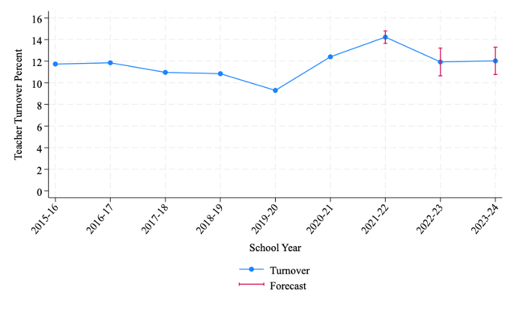
National Teacher Attrition Forecast
Turnover Rate is estimated from prior year data. Pink lines indicate a forecasted attrition rate with corresponding confidence intervals.
National Attrition
NC Attrition
Nguyen, T. D., Lam, C. B., & Bruno, P. (2022). Is there a national teacher shortage? A systematic examination of reports of teacher shortages in the United States. (EdWorkingPaper: 22-631). Annenberg Institute at Brown University. https://doi.org/10.26300/76eq-hj32

Slide 5
North Carolina Teacher Attrition and Vacancy Data
Reporting Year | State Attrition Number | State Attrition Rate | New Hires (September of following School Year) | State Replenishment Rate | State Vacancy Rate
2017-2018 | 7,674 | 8.1% | 9,013 | 117.4% | 1.5%
2018-2019 | 7,115 | 7.5% | 8,850 | 124.4% | 3.2%
2019-2020 | 7,111 | 7.5% | 7,332 | 101.3% | 1.7%
2020-2021 | 7,735 | 8.2% | 10,025 | 129.6% | 3.4%
2021-2022 | 7,280 | 7.8% | 11,496 | 157.9% | 5.9%*
2022-2023 | 10,373 | 11.5% | 11,023 | 106.3% | 6.4%*
Average | 7,881 | 8.43% | 9,623 | 122.8% | 3.68%

Slide 6
North Carolina Attrition and Replenishment Data
Replenishment (New Hires) is measured in September of the following school year (2023-2024)
Attrition data is measured from March of the prior school year (2022) to March of the following school year (2023).

Slide 7
National Teacher Attrition Forecast
National Attrition
NC Attrition
Nguyen, T. D., Lam, C. B., & Bruno, P. (2022). Is there a national teacher shortage? A systematic examination of reports of teacher shortages in the United States. (EdWorkingPaper: 22-631). Annenberg Institute at Brown University. https://doi.org/10.26300/76eq-hj32

Slide 8
Contextualizing Attrition and Vacancy Data

Slide 9
National Public Sector and Education Vacancy
All public sector industries excluding farming (pink)
All state and local government excluding public education (teal)
Public education (aqua)

Slide 10
Contextualizing the Data – Attrition from North Carolina State Agencies
2023_03_13v2-Recruitment Vacancy and Retention Metrics in North Carolina State Government80 - DocumentCloud

Slide 11
Attrition and Teacher Experience

Slide 12
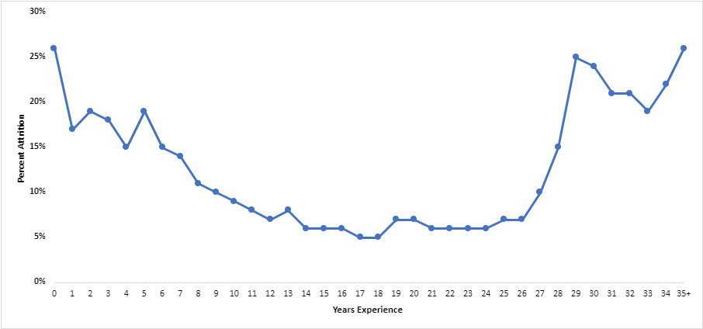
NC Teacher Attrition by Teaching Experience
Attrition for teachers in the early years of the profession is possibly more responsive to SBE policy initiatives. Decisions to leave the profession may include mentor support, manageable workload, and other policy-relevant working conditions.
Attrition for teachers in this area is likely resistant to SBE policy initiatives. Decisions to remain in or leave the profession are likely financial. SBE policies would be in conflict with retirement benefits.
26%
26%
5%

Slide 13
License Routes of NC Newly Hired Teachers
Contribution of Traditional Route has decreased 24.3% since 2017-18
Contribution of Alternative Route has increased by 23.3% since 2017-18
Contribution of Out-of-State Route has decreased 25.6% since 2017-18
Contribution of International Route has increased by 148.2% since 2017-18
License Route
Year | Traditional | Alternative /Residency | Out-of-State | CTE | International | Other
2017-18 | 30.98% | 35.93% | 26.52% | 1.95% | 4.15% | 0.47%
2018-19 | 32.09% | 34.40% | 25.37% | 1.74% | 6.03% | 0.36%
2019-20 | 35.57% | 33.54% | 26.53% | 1.97% | 2.03% | 0.36%
2020-21 | 31.57% | 36.47% | 24.96% | 1.79% | 4.92% | 0.30%
2021-22 | 26.66% | 40.52% | 21.43% | 1.98% | 9.17% | 0.23%
2022-23 | 23.44% | 44.31% | 19.75% | 1.95% | 10.30% | 0.24%

Slide 14
License Types for Newly Hired Educators*
School Year | CPL | IPL | Lateral | Permit to Teach | Emergency | Residency
2017-18 | 19.72% | 39.93% | 30.35% | 0.69% | 1.69% | 0.37%
2018-19 | 20.48% | 40.08% | 8.64% | 8.04% | 4.88% | 9.71%
2019-20 | 20.51% | 44.93% | 0.75% | 9.34% | 4.39% | 16.08%
2020-21 | 18.72% | 40.51% | 0.40% | 10.24% | 9.72% | 13.66%
2021-22 | 17.29% | 33.87% | 0.45% | 10.88% | 14.65% | 11.66%
2022-23 | 12.53% | 33.17% | 0.14% | 10.70% | 21.36% | 9.80%
Experienced teachers who return to the professional make up a substantial portion of our annual new hires, but this group has been decreasing over time.
Teachers who have completed the traditional route to licensure (preparation embedded in undergraduate degree and student teaching) represents about 1/3 of the state’s new teacher hires.
These three licenses articulate to form the “alternative” route to licensure. Educators can begin with any of the three licenses and progress left to right.
The alternative route to licensure accounts for 41.9% of the new hires in 2023-24. This represents a 40.6% increase in this path to licensure since the sunset of Lateral Entry (2019-2020).
*Newly Hired is defined as an educator who has not been employed as a licensed educators in the prior three school years.

Slide 15
Completion Data for Alternatively Licensed Teachers (Issued Permit to Teach in 2018-19, 2019-20, and 2020-21)
A total of 2,547 teachers were issued Permits to Teach in school years 18-19 through 20-21.
Of those 2,547 teachers, 55% (1,403) converted that Permit to a Residency License.
More than a third (36%) of those issued permits did not continue on the licensure pathway.

Slide 16
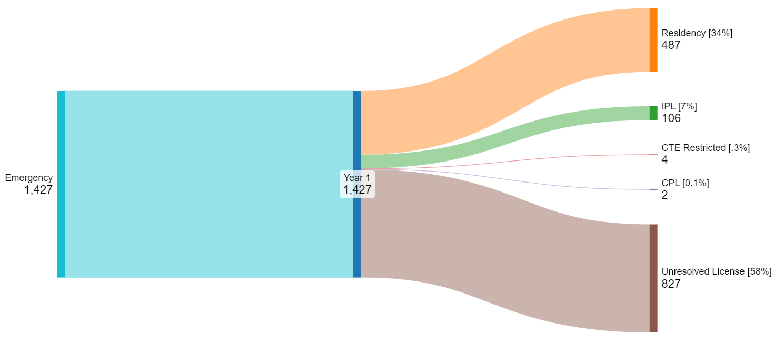
Completion Data for Alternatively Licensed Teachers (Issued Emergency License in 2018-19, 2019-20, and 2020-21)
A total of 1,427 teachers were issued Emergency Licenses in school years 18-19 through 20-21.
Of those 1,427 who were issued ELs, 34% (487), converted the EL to a Residency License.
Over half (58%) of the Emergency Licenses issued in this time period did not convert to another license type.

Slide 17
Beginning vs. Experienced Teacher Attrition
 | 2022-23 | 2021-22
LEA Reported Beginning Teachers | 10,104 | 13,169
BT Attrition Rate | 15.1% | 13.1%
LEA Reported Experienced Teachers | 80,262 | 80,663
Exp Teacher Attrition Rate | 10.69% | 6.9%

Slide 18
Identifying Beginning Teachers
 | 2022-2023 | 2021-2022
LEA Reported Beginning Teachers | 10,103 | 13,169
NCDPI Identification | 13,534 | 15,621
Teacher Self-Report from Teacher Working Conditions Survey | N/A | 14,387
Data from the 2021-22 TWC survey shows 14,387 teachers identified as BTs. Survey data indicates that 860 (6.0%) reported that they were not assigned a mentor and 2554 (17.8%) indicated that they received no additional support as a BT.
NCDPI used Licensure type and issue date to identify teachers who should be identified as Beginning Teachers. NCDPI analysis suggests that BTs are underreported and/or underserved by 34% in 2022-23 and 18.6% in 2021-2022.
LEAs report to NCDPI the number of teachers who are enrolled in their Beginning Teacher Support Programs (BTSP)

Slide 19
Defining Vacancy

Slide 20
Defining Vacancies
Open Positions
Permanent Positions
Reflected in vacancy data through the 2020-21 SY.
Focuses on the number of positions without an adult.
Once filled, position is no longer counted as vacant.
Blind to whether the replacement is licensed or not.
Reflected vacancy data for SY 2021-22 and beyond.
Focuses on having a fully qualified educator in a permanent position.
If position is filled by educator with certain types of licenses, then vacancy persists.
Rehired retirees (regardless of licensure status) do not count toward filling the vacancy.

Slide 21
Monitoring Capacity of Teaching Profession
The statutory change in measuring vacancies means that vacancy rates are not comparable from year to year (specifically from 2021-22 to earlier years).
Teachers who hold an emergency or permit to teach license are counted as vacancies.
Rehired retirees and provisionally licensed teachers count as vacancies.
Long-term subs and other unlicensed employees count as vacancies.
Federal regulations allow NC to count any licensed teacher as qualified, but state statute requires us to identify them as vacancies.

Slide 22
Unpacking 2022-23 Vacancy Rates
Total Vacancy Count – 6,008
Minus Emergency Licenses (1,685) – 4,323
Minus Permits to Teacher (844) – 3,479
Estimate of open position rate in NC LEAs (cf. to rates in 2020-2021 and prior).
3.7%

Slide 23
Summary and Policy Implications

Slide 24
Summary of Main Findings
The North Carolina teacher attrition rate has increased this year to 11.5%.
NC public school units have been able to hire new teachers at a rate that exceeds attrition rates.
Other public sectors, including NC State Government, have shown increases in attrition as well.
Teacher attrition is not uniform across years of experience. Early- and late-career teachers show high rates of attrition relative to mid-career teachers.
How teachers enter the profession, in terms of license and pathway, has shifted over the years.

Slide 25
Summary of Main Findings
The alternative pathway to licensure shows serious “leaks” on the route to Residency Licensure.
Vacancy rates in North Carolina public schools shows an increase over the prior year.
Changes in statute that define vacancies (2021) makes direct comparisons to prior years meaningless.
Accounting for the statutory changes allows us to estimate the percentage of classrooms without a licensed educator.

Slide 26
Policy Implications
The data presented in the State of the Teaching Profession Report and this presentation suggest that early-career teachers are not being supported enough, or in the most helpful ways.
Policies related to beginning teacher support were developed at a time when the traditional route to licensure was the dominant pathway to teaching.
NCDPI recommends a review of the Board’s Beginning Teacher Support policy and program to find ways to better support teachers who are entering the profession from other professions and/or without formal pedagogical training.

